Slide 1
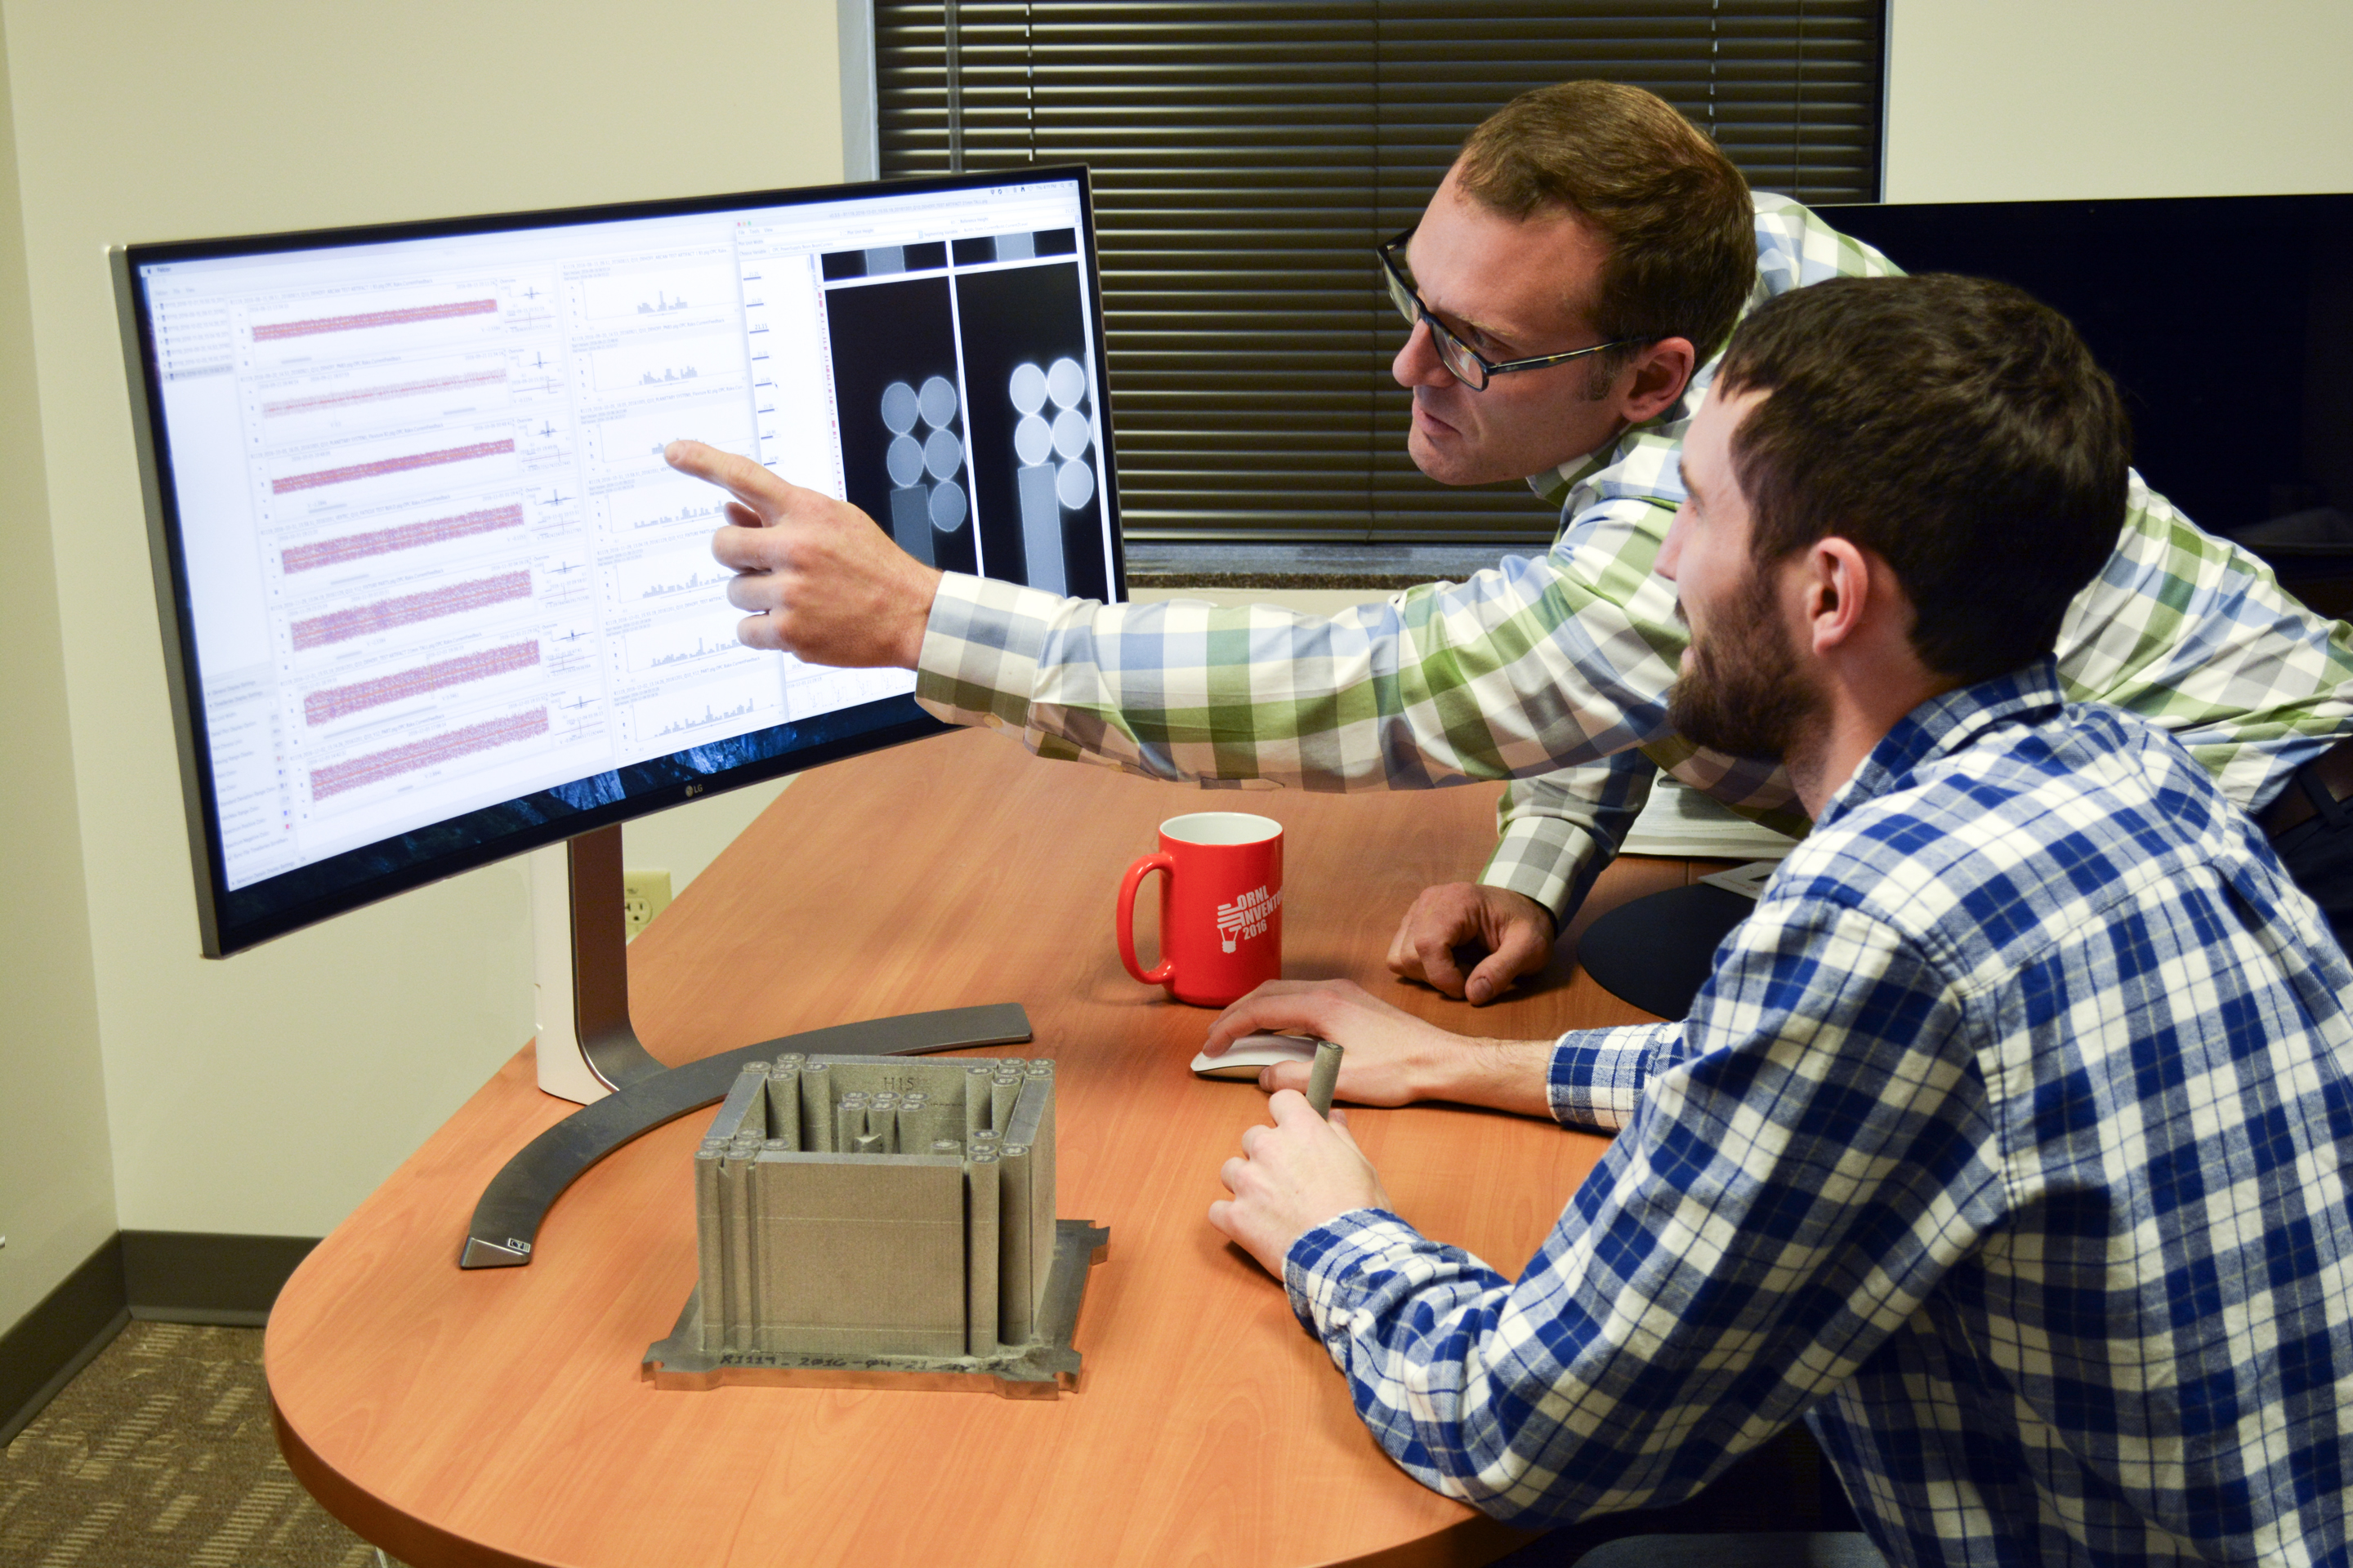
Chad A. Steed ∙ CDA Group ∙ steedca@ornl.gov
Research Focus: Improve human capacity to explore large and complex data by integrating data visualization and automated analytical algorithms
Preserves human ingenuity in scientific analysis while leveraging computational guidance
Increases scale and depth of data exploration, which increases probability of new discoveries in key domains
Interdisciplinary Collaborations/Applications: Materials science, climate science, additive manufacturing, cyber security, cyber physical systems, health care, and national security
Practical Results: Open source systems (CrossVis, EDEN, Falcon), patented systems (Matisse, MDX), long-standing collaborations, publication and commercialization awards, R&D 100 award

Slide 2
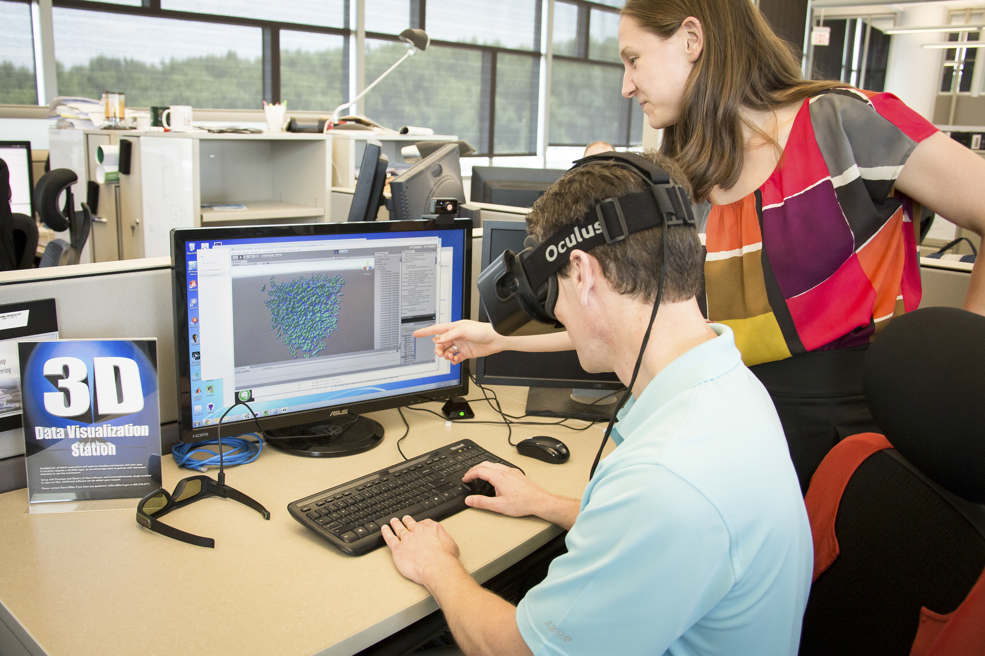
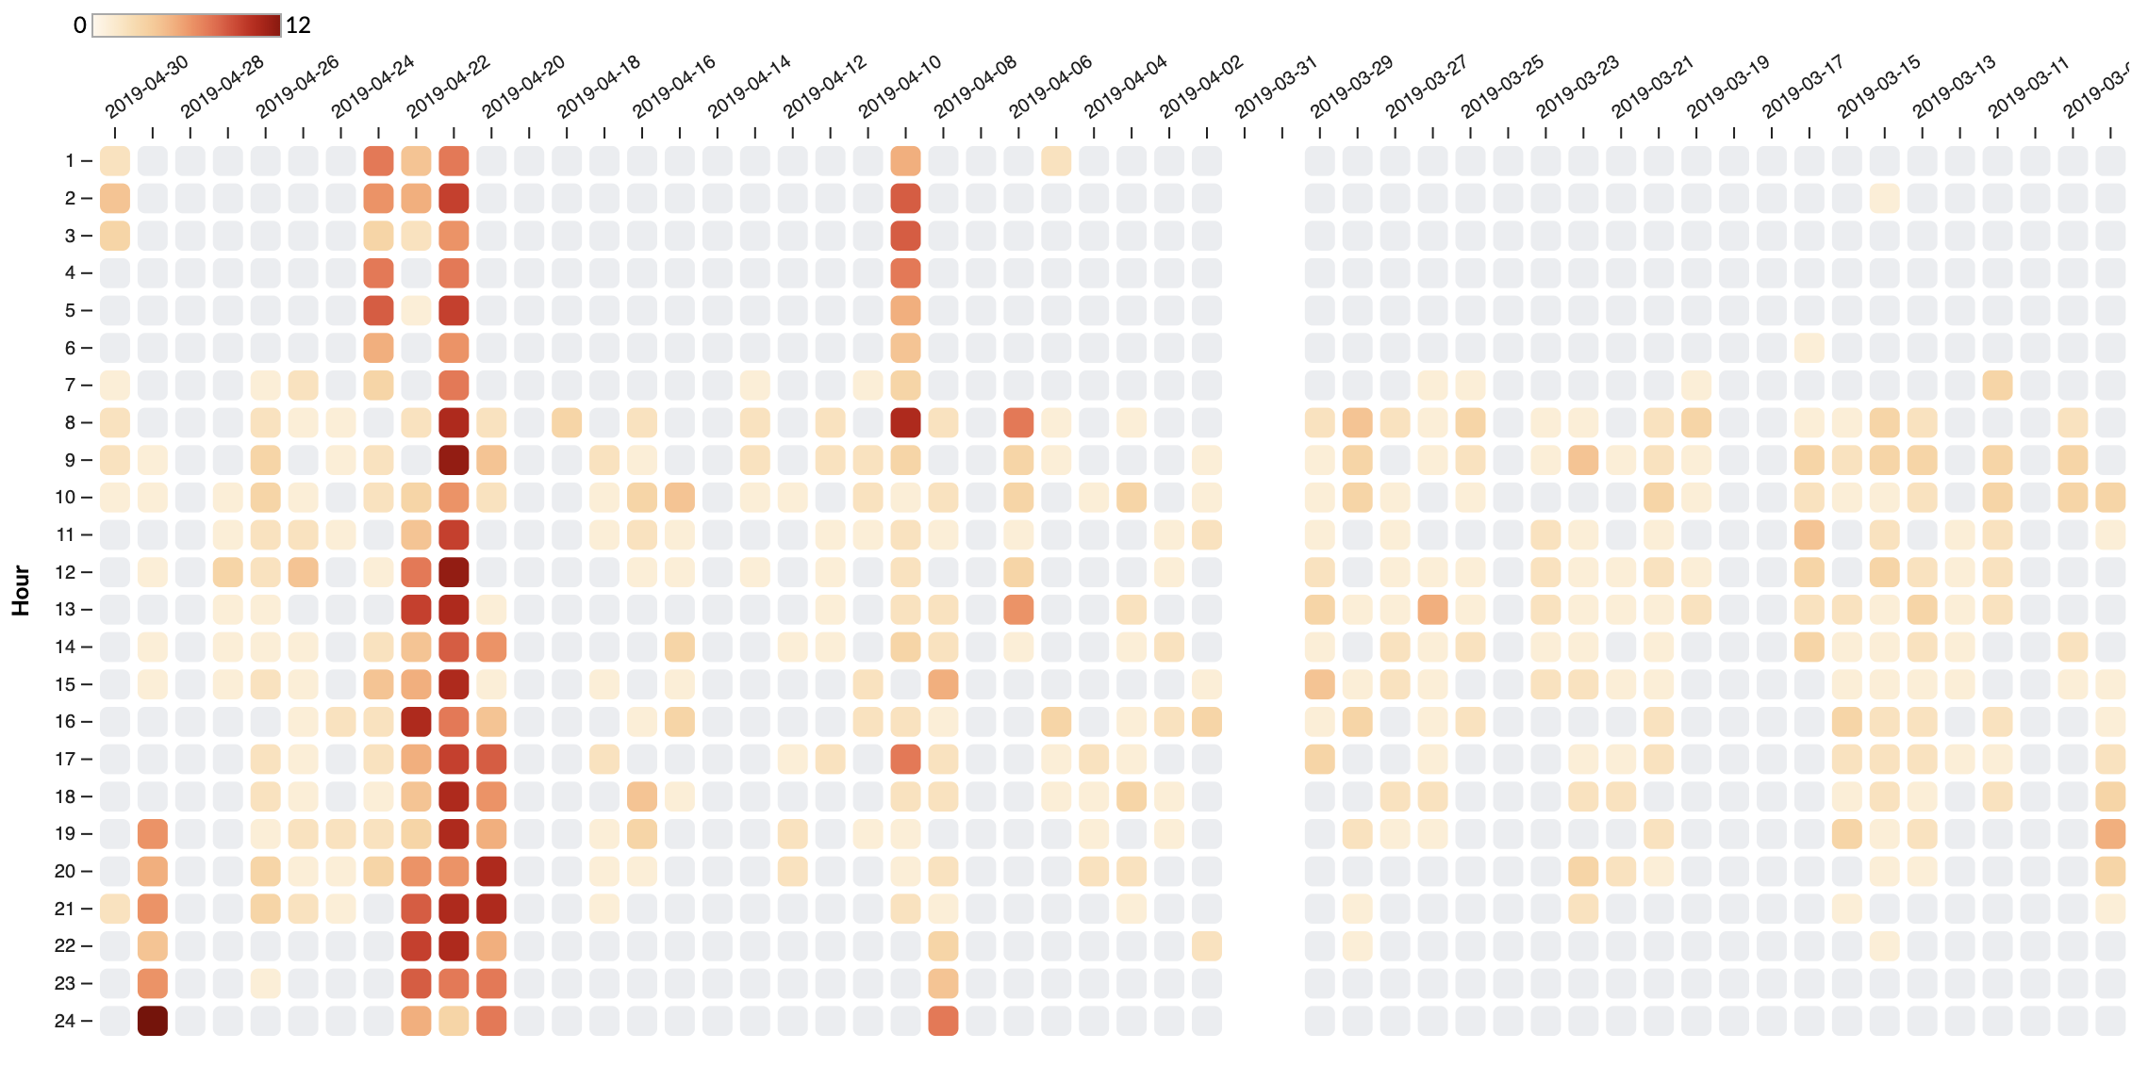
Chad A. Steed ∙ CDA Group ∙ steedca@ornl.gov
Recent Scientific Data Analysis Projects
SciDAC RAPIDS: Visual analytics to materials and climate science
BER Climate Simulation: Visual analysis of large scale, multidimensional data sets from Earth system models
Materials Science: Applications of visual analytics and new VR/AR approaches for Explainable AI and general scientific data exploration
Recent National Security Projects
Cyber Security: Find and explore anomalies in computer network traffic
Cyber Physical: Explore sensor data streams to improve resiliency in critical systems (e.g., power grid, user facilities, manufacturing)
Nuclear Nonproliferation: Analyze the performance of radiation detection systems

Slide 3
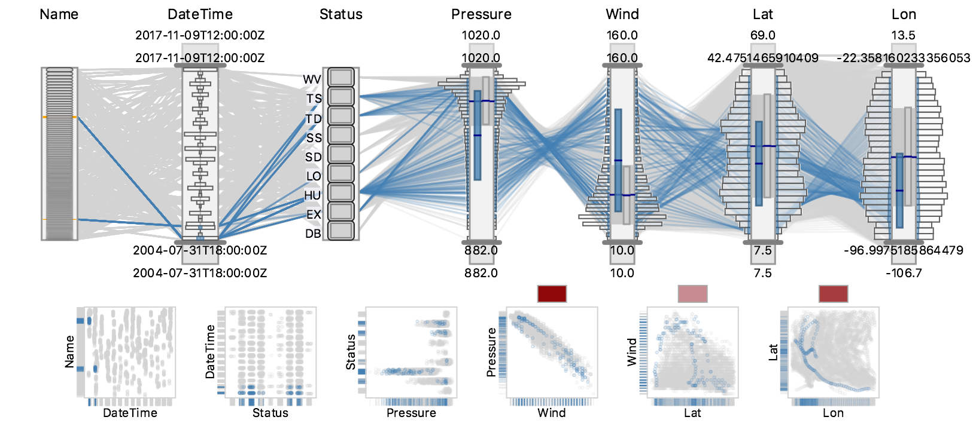
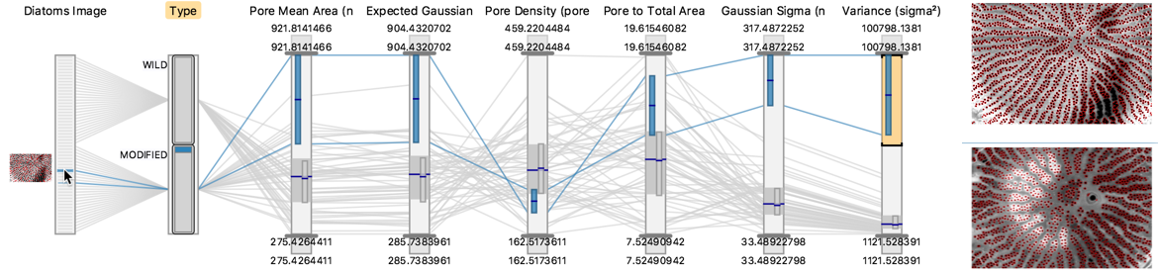
CrossVis: Guided Exploratory Data Analysis
Scientific Achievement
CrossVis enables flexible exploration and comprehensive understanding of large, heterogeneous, and multivariate data by integrating interactive visualizations and statistical analytics.
Significance and Impact
CrossVis helped materials scientists at ORNL CNMS understand and improve a neural network classification process for microscopic imagery with genetic engineering applications.
CrossVis allowed ORNL BER climate scientists to consider more variables from large scale, land model parameter sensitivity analyses and ultimately improve DOE model accuracy.
Research Details
CrossVis implements theoretical information foraging concepts, whereby information dynamically derived from statistical analytics are used to augment interactive data visualizations making key patterns visually salient.
CrossVis provides an advanced multivariate visual analytics framework supporting heterogenous data types (e.g., images, temporal, categorical), progressive high-performance rendering, and a scalable data model.
Design requirements stem from over a decade of experience collaborating with scientists from a variety of domains.
Exploration of Historical Hurricane Observations
Analyze Neural Networks for Microscopic Imagery
CrossVis is a visual analytics tool that integrates statistical analytics and an extended version of parallel coordinates to allow flexible exploratory of large and heterogenous multivariate data. In addition to climate and materials science, CrossVis has been applied to cyber security, manufacturing, power grid, and system performance projects.
Citation: A. Trofimov, … C. Steed. “Deep Data Analytics for Genetic Engineering of Diatoms Linking Genotype to Phenotype via Machine Learning”, npj Computational Materials, 2019.

Slide 4
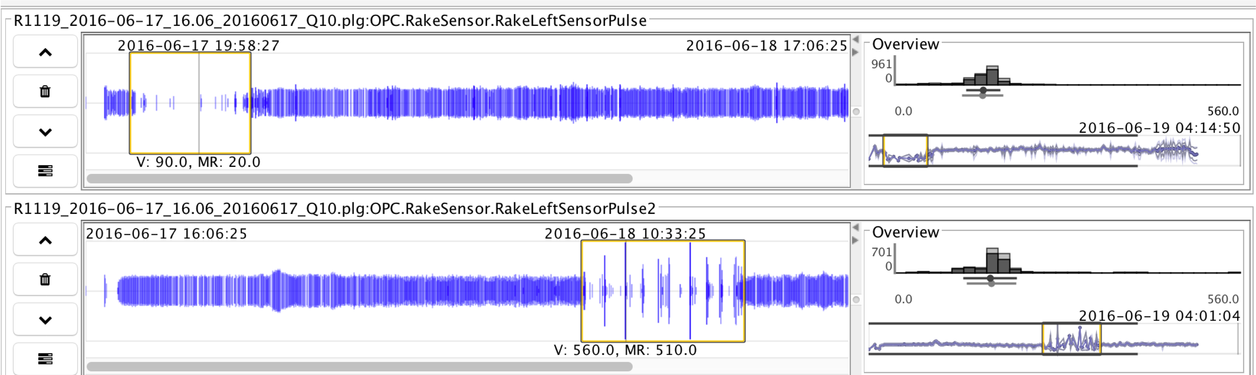
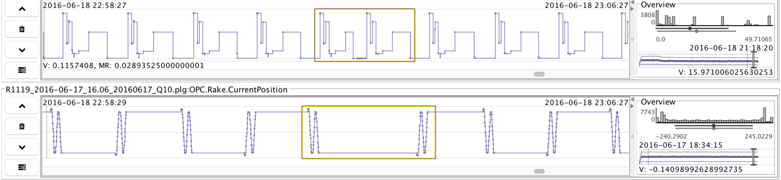
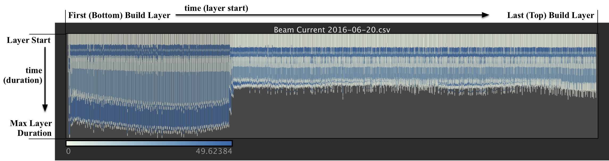
Falcon: Visual Analysis of Large, Irregularly Sampled, Multivariate Time Series Data for Additive Manufacturing
A new visual analytics system for exploratory analysis of large and complex time series data
Integrates several interactive data visualization techniques extending the limits of conventional time series analysis methods
Semi-supervised machine learning agents learn the user’s interest and provide guidance to interesting relationships for scalable exploration
Novel segmented time series data visualization methods that provide overviews and details
Applied successfully to additive manufacturing, climate, and cyber security domains
Gain understanding of why 3D printing defects occur
Climate model ensemble sensitivity analysis
Reveal network flow patterns in cyber attacks
Applicable to AI algorithm analysis
Citation: C. Steed, R. Dehoff, W. Halsey, S. Yoder, S. Powers, and V. Paquit, “Falcon: Visual Analysis of Large, Irregularly Sampled, and Multivariate Time Series Data in Additive Manufacturing”, Computers & Graphics, 2017.

